Slide 1

Green Pace
Security Policy Presentation
Developer: Ashley Santo

Slide 2

OVERVIEW: DEFENSE IN DEPTH
This security policy defines the secure coding principles and standards that should be followed in order to prevent or delay attacks.

Slide 3
THREATS MATRIX
The coding standards within this policy go through a risk assessment to determine how critical they are. This helps indicate how disastrous the consequences may be if the standard is ignored.
Likely STD-007-CPP, STD-008-CPP, STD-001-CPP, STD-002-CPP | Priority STD-003-CPP, STD-004-CPP, STD-005-CPP
Low priority STD-010-CPP | Unlikely STD-006-CPP, STD-009-CPP

Slide 4
10 PRINCIPLES
Validate Input Data
Heed Compiler Warnings
Architect and Design for Security
Keep It Simple
Default Deny
Adhere to the Principle of Least Privilege
Sanitize Data Sent to Other Systems
Practice Defense in Depth
Use Effective Quality Assurance Techniques
Adopt a Secure Coding Standard

Slide 5
CODING STANDARDS
Do not attempt to create a std::string from a null pointer
Do not store an already-owned pointer value in an unrelated smart pointer
Properly deallocate dynamically allocated resources
Make sure that integer conversions do not cause lost or misinterpreted data
Valid references, pointers, and iterators should be used to reference elements in a container
The order of evaluation should not be depended on for side effects.
All exceptions thrown should be handled before the main() function begins it’s execution
Do not alternate input and output from a stream without flushing or an intervening positioning call
Virtual functions can’t be invoked from constructors or destructors.
Use static assertion techniques to test expressions in code

Slide 6
ENCRYPTION POLICIES
Encryption at rest: refers to any data residing in computer storage that is inactive and not moving between devices or network points. Stored data should be encrypted.
Encryption in flight: refers to any data that is being transmitted over a network that has the potential to be intercepted. Data should be encrypted before transmission.
Encryption in use: refers to the protection of data regardless of its location or lifecycle stage (in flight/at rest).

Slide 7
TRIPLE-A POLICIES
Authentication: the method of identifying a user. Credentials should be compared to a stored database to verify the user and grant access.
Authorization: the process of determining user permissions. Permissions decide what the user can do or access.
Accounting: monitors resources a user consumes during network access. This allows for tracking and other analyses.

Slide 8
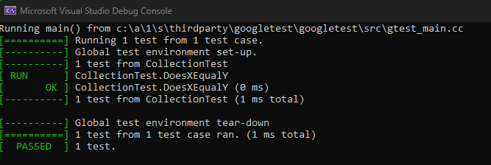
Unit Testing: Does x equal y?(Positive)
This is an example of a simplistic coding vulnerability of whether two integers equal each other and if added together, would they come out to the specified value.
The first test is a positive test of making sure the variable x equals y.

Slide 9
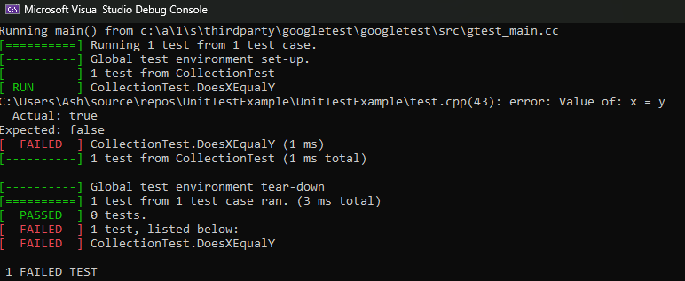
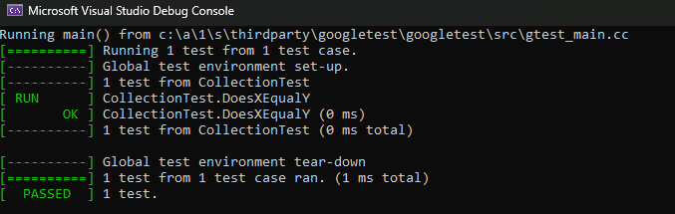
Unit Testing: Does x equal y?(Negative)
The second and third tests are negative tests that are supposed to fail. The check is to confirm x does not equal y.
Test one uses ASSERT_FALSE when x equals y.
Test two uses ASSERT_FALSE when x doesn’t equal y.

Slide 10
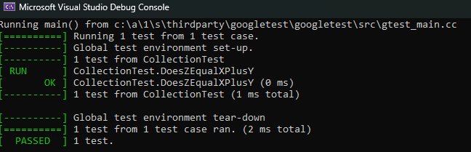
Unit Testing: Does z equal x plus y?
The last test checks to see if the variable z is equal to x added to y.

Slide 11

AUTOMATION SUMMARY

Slide 12
TOOLS
DevSecOps stands for development, security, and operations that integrates security as a shared responsibility throughout the entire development lifecycle. It also includes utilizing automation to smooth the process of checks along the way.
Examples of tools used:
Open Source Vulnerability Scanning
Testing Tools
Image Scanning
Infrastructure Automation Tools
Dashboard and Visualization Tools
Threat Modeling
Alerting Tools

Slide 13
RISKS AND BENEFITS
Acting quickly or waiting to respond to vulnerabilities is dependent on the risk assessment. High risk vulnerabilities should be handled right away while low risk vulnerabilities can probably wait. But, if the cost to fix the issue is high, it might get pushed back behind issues that are low cost to fix. This is where the strategy is lacking in that every issue comes with it’s own risk assessment and certain factors outweigh others. The risks could be that even though a high risk item is low cost to fix, it might not have the same severity in consequences as a high cost vulnerability that is also high risk.
Each risk should be assessed to determine the overall severity of the consequences should an attacker try to exploit it. From there, determine the cost and likelihood ignoring it for will lead to exploitable code.

Slide 14
RECOMMENDATIONS
One of the major gaps is that not every security risk is going to come from vulnerable code. Sometimes, attackers utilize social engineering or other tactics to gain access.
Example: Uber Security Breach on September 15, 2022.
Attacker claimed to be an IT worker for corporate to persuade the employee to approve access.
Uber stated that the employee’s account was compromised and most likely, information was bought on the dark web
Attacker spammed the two-factor authentication requests until the employee accepted and the attacker was given access.
From there, they were able to get access to other employee accounts granting elevated permissions and gaining access to all of Uber’s code and other internal systems.
More can be read here at from the Uber Newsroom on the topic:
https://www.uber.com/newsroom/security-update/
Recommendations for future policies: Staff training and policies on what to look out for with other potential methods attackers may use. There is more to security than just vulnerable code. There is physical and social security risks that can also be used to access restricted areas in the network.

Slide 15
CONCLUSIONS
In conclusion, following the policies, principles and standards listed here are going to help prevent potential breaches in security. Security should always be considered a top priority regardless of the lifecycle stage the software is in. It’s up to everyone on a team to work together to prevent vulnerabilities from being exploited.
New standards should be added as they become relevant or the risk of creating a specific vulnerability is high.

Slide 16
REFERENCES
Conger, K., & Roose, K. (2022, September 15). Uber investigating breach of its computer systems. The New York Times. Retrieved from https://www.nytimes.com/2022/09/15/technology/uber-hacking-breach.html
Schiela, R. (Ed.). (n.d.). SEI cert C++ coding standard. Confluence. Retrieved from https://wiki.sei.cmu.edu/confluence/pages/viewpage.action?pageId=88046682
Uber. (2022, September 19). Security update. Uber Newsroom. Retrieved from https://www.uber.com/newsroom/security-update/

